Slide 1
Mathematical & Statistical Programming
Learning Objectives
Describe the core features of NumPy arrays
Create, index, and manipulate NumPy arrays to solve data problems
Use masking and querying syntax to retrieve desired values
Use vectorised ufuncs
Expected Prior Knowledge
Experience of working with data using Data Analysis tools such as Excel.

Slide 2
Activity: Tutorial
Code along with the trainer for the following tutorial
Ask questions if you encounter errors
Think about the code you are writing

Slide 3
Why Numpy?

Slide 4
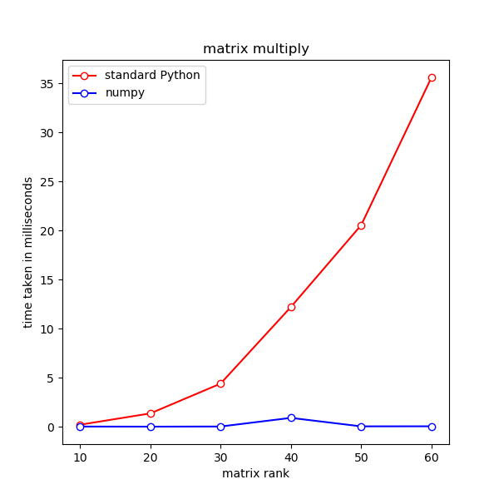
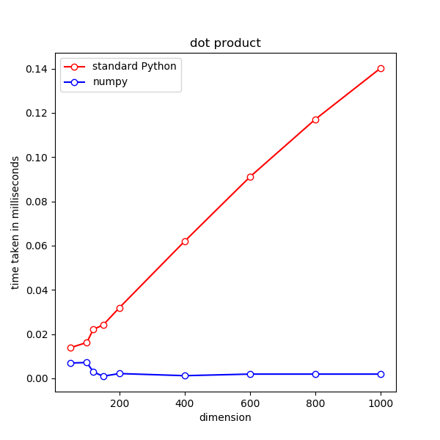

Python collections are not designed for computational efficiency.
C and FORTRAN arrays are much more efficient computationally than Python lists for large datasets.
Python is slow

Slide 5
NumPy was introduced in 2006 to address the inefficiencies of Python in dealing with large amounts of data.
Written in C and FORTRAN
Internal data structure uses C arrays
Python API for seamless integration with Python
Provides its own array types (ND-arrays)
Arrays retain most Python collection behaviours, so that it looks and feels ‘native’ to Python language
Incorporates fast maths libraries, such as OpenBLAS (default, open source), for efficient linear algebraic operations (dot products, matrix multiply, etc.)
NOTE: To use NumPy it is necessary to import it
import numpy as np
What is NumPy?

Slide 6
NDArrays

Slide 7

ND-arrays stands for N-dimensional arrays
The basic data type in NumPy, intended to replace Python’s list
Can be created from Python’s list using numpy.array()
nd-arrays are mutable
numpy.arange() produces a sequence of numbers contained in an array
ND-arrays

Slide 8
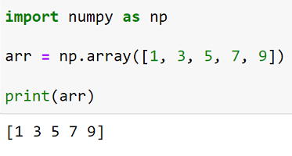
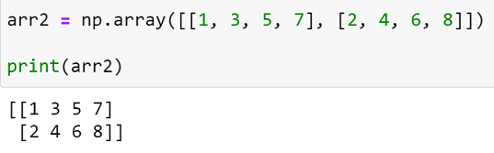
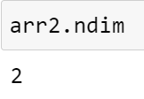
Creating a 1-dimensional array
Creating a 2-dimensional array
The ndim attribute returns the number of dimensions of the array
ND-arrays

Slide 9
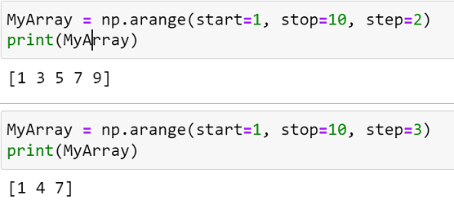
arange() creates an array with evenly spaced values.
start - the first value in the array.
stop - the number that defines the end of the array. It is not included in the array.
step - the spacing (difference) between each two consecutive values in the array. The default step is 1. Step cannot be zero.
dtype - the type of the elements of the output array. Defaults to None. If dtype is omitted, arange() will try to deduce the type of the array elements from the types of start, stop, and step.
numpy.arange([start, ]stop, [step, ], dtype=None)
ND-arrays

Slide 10
All arrays can only contain elements of the same data type.
→ This is valid for ND-arrays too
The type of the element in an array is recorded as a dtype object
Standard Python data types can be used as dtypes: e.g., int, float, str
dtype of an array can be obtained using array.dtype property
We can perform type conversion using array.astype(new_type)
The new_type must be compatible with the original type of the elements
If in doubt, NumPy automatically converts an array to an array of strings
Dtype

Slide 11
The built-in function len() does not work with nd-arrays
To find out the size of a nd-array, use array.size property
To find out the shape (size of each dimension) of an array, use array.shape property
To change the shape of an array, use array.reshape()
NOTE: It is the programmer’s responsibility to make sure the new shape is compatible with the total number of elements.
nd-Array shape and sizes

Slide 12
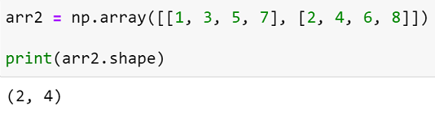
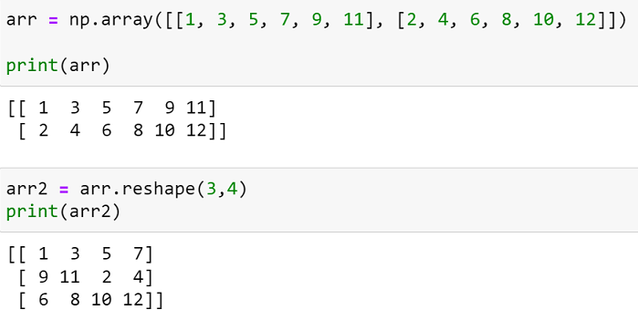
The shape attribute returns a tuple with the number of elements in each dimension.
2 rows, 4 columns
Reshaping an array means change the number of dimensions or change the number of elements in each dimension. This is done using reshape()
nd-Array shape and sizes

Slide 13
Array Manipulation

Slide 14
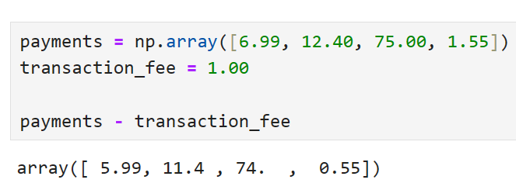
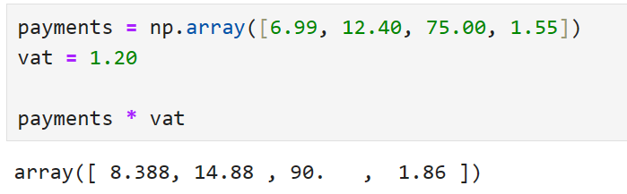
Broadcasting Operations
Notes:
Numpy broadcasts operations element-wise, making computations with over arrays simple. The operators which can be used will depend on the array type, but generally speaking, all numeric & Boolean operators are valid for numeric types, and all Boolean operators for string types.
The results of Boolean operations can be combined, though numpy strays from python’s use of the and and or statements, favouring instead the operators & and |. Interestingly, ~ is the not operator.

Slide 15
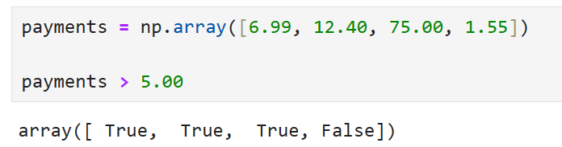
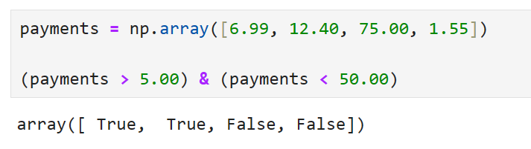
Elementwise operators
~ NOT
& AND
| OR
^ XOR
Broadcasting Operations
Notes:
Numpy broadcasts operations element-wise, making computations with over arrays simple. The operators which can be used will depend on the array type, but generally speaking, all numeric & Boolean operators are valid for numeric types, and all Boolean operators for string types.
The results of Boolean operations can be combined, though numpy strays from python’s use of the and and or statements, favouring instead the operators & and |. Interestingly, ~ is the not operator.

Slide 16
Standard Python list slices:
array[i] obtains the i-th element
array[n:m] obtains the elements array[n], array[n+1], …, array[m-1] in a new array
array[I,j] obtains the element on row I and column j of a 2-dimensional array
New to ND-arrays:
Cherry-picking
array[[2, 4, 5, 1]] obtains the elements array[2], array[4], array[5], array[1] in a new array
Cherry picking list can be any Python iterator with integer elements
Filtering
array[[True, True, False, … False, True]] obtains the elements from positions marked as True in a new array, omits those marked by False
Filter list can be any Python iterator with Boolean elements, and its length must be the same as the array
The filter list is usually computed rather than written by hand
Slicing and dicing

Slide 17
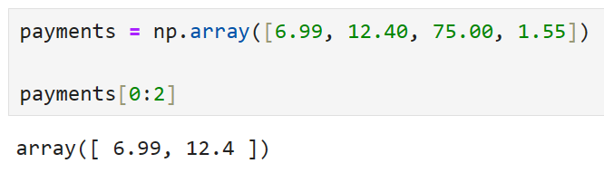
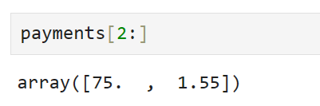
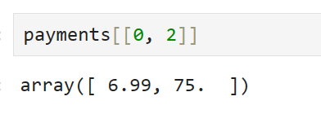
Slicing and dicing

Slide 18
Mathematical & Statistical Methods

Slide 19
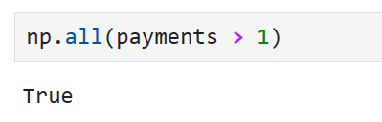
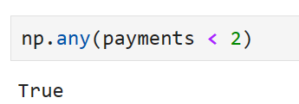
Functions acting on entire array
numpy.all()
numpy.any()
Logical operators and functions

Slide 20
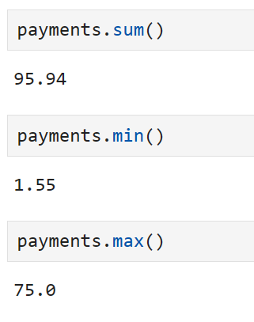
NumPy comes with a full set of statistical functions:
numpy.sum()
numpy.min()
numpy.max()
Descriptive (Summary) statistics

Slide 21
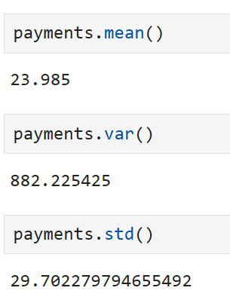
NumPy comes with a full set of statistical functions:
numpy.mean()
numpy.median()
numpy.var()
numpy.std()
numpy.corrcoef()
Descriptive (Summary) statistics

Slide 22
Ufuncs

Slide 23
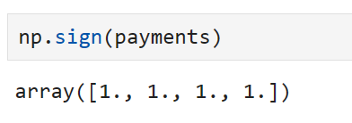
A universal function, or ufunc, is a function that performs element-wise operations on data in ndarrays.
They are fast!
numpy.sqrt()
numpy.square()
numpy.exp()
numpy.log()
numpy.sign()
numpy.isnan()
numpy.sin()
numpy.add()
Universal Functions

Slide 24
04_Mathematical_and_Statistical_Programming_with_Numpy_Exercise.docx
Exercise

Slide 25
Learning check
Think about your answers to these questions
What are the core features of NumPy arrays
When manipulating numpy arrays, what do we need to keep track of?
How does numpy allow us to query data stored in arrays?
What are ufuncs? What are some examples of them?

Slide 26
How did you get on?
Learning Objectives
Describe the core features of NumPy arrays
Create, index, and manipulate NumPy arrays to solve data problems
Use masking and querying syntax to retrieve desired values
Use vectorised ufuncs

